Slide 1
WELCOME TO VR TOURISM
BY:
S.GOKUL
N.RAVISANKARAN
G.LENA THAMILVANAN

Slide 2
What is Virtual reality ?
Virtual Reality, or VR, is the use of computer technology to create a simulated environment which can be explored in 360 degrees. Unlike traditional interfaces, VR places the user inside the virtual environment to give an immersive experience

Slide 3
VR Components :
The components necessary for building and
experiencing VR can be divided into nine categories

Slide 4
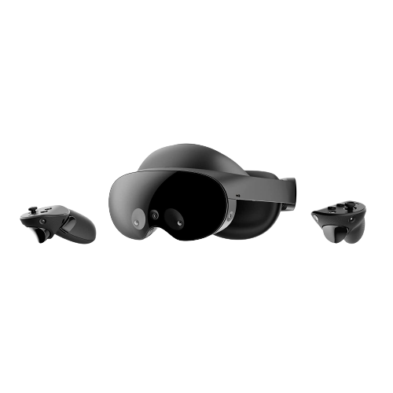
Hardware:
Mobile- Android(or) IOS
Computer
Input Devices
VR Box

Slide 5
Software:
V360 Application
Filmora - X
2D Graphics
Digital Sound Editing
VR Simulation

Slide 6
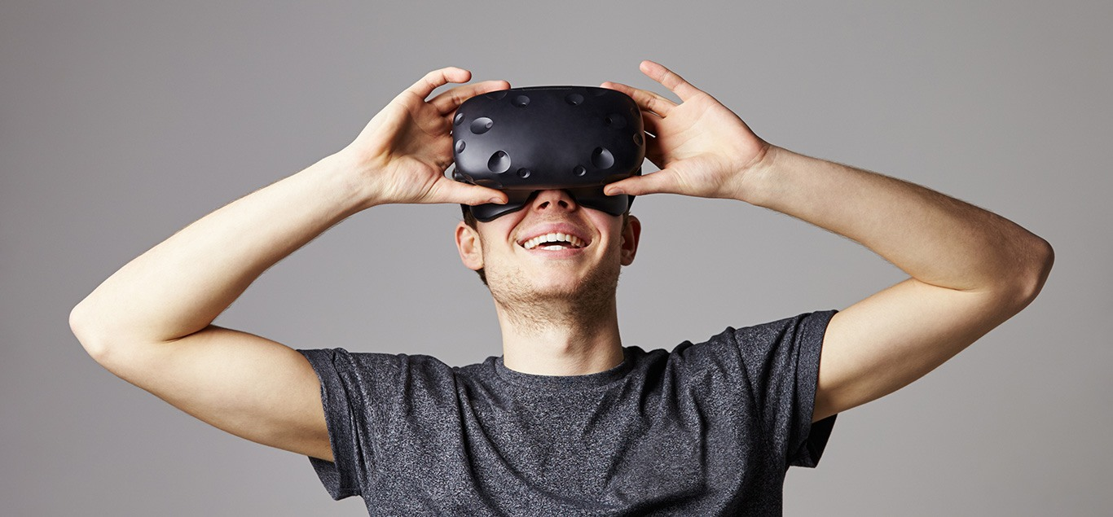
Our Project to Experience the Real Experience.

Slide 7
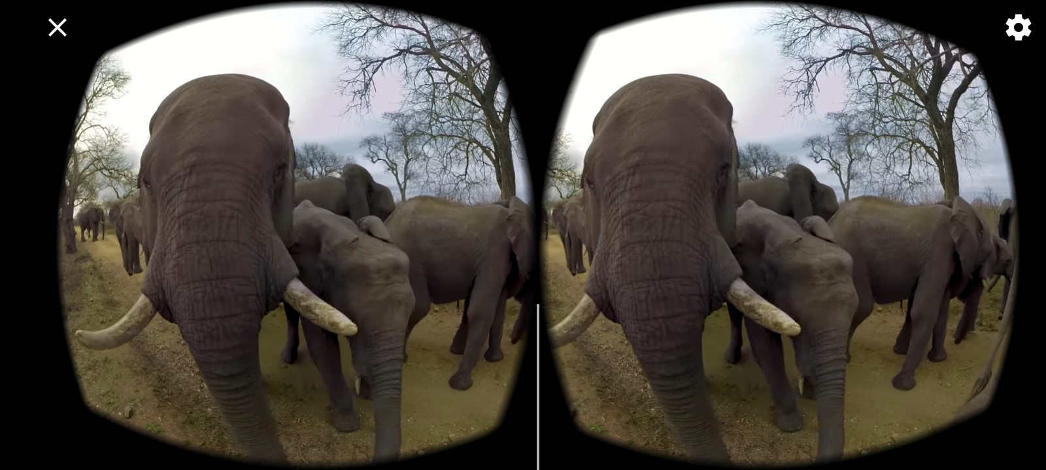
EXAMPLE :
fedfdfdfdf
Video Formate

Slide 8
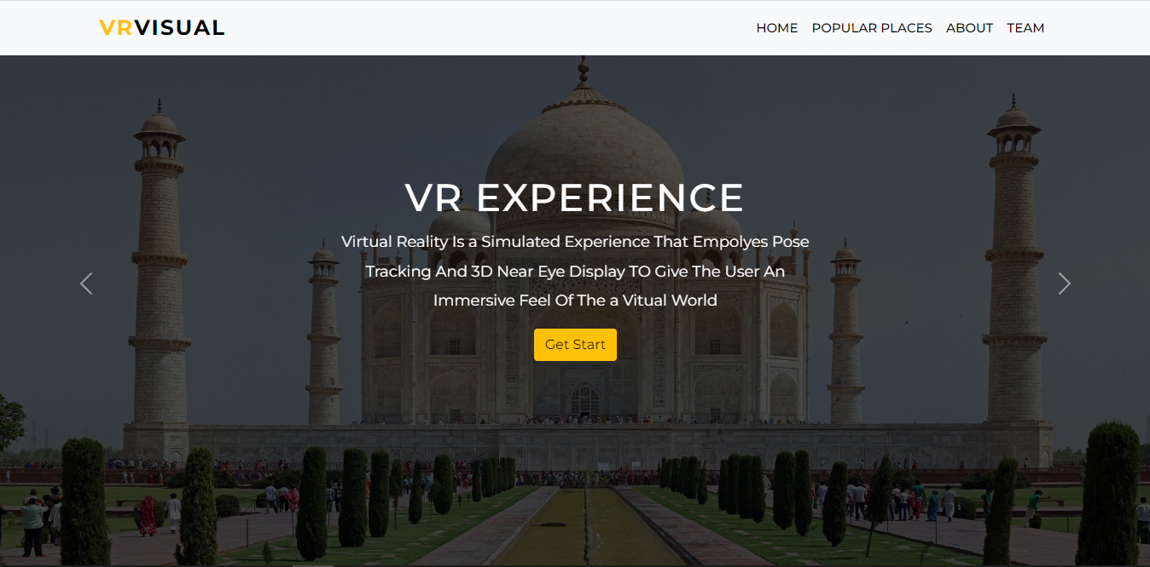
EXAMPLE :
dfdfdfdf
On Mobile Website View

Slide 9
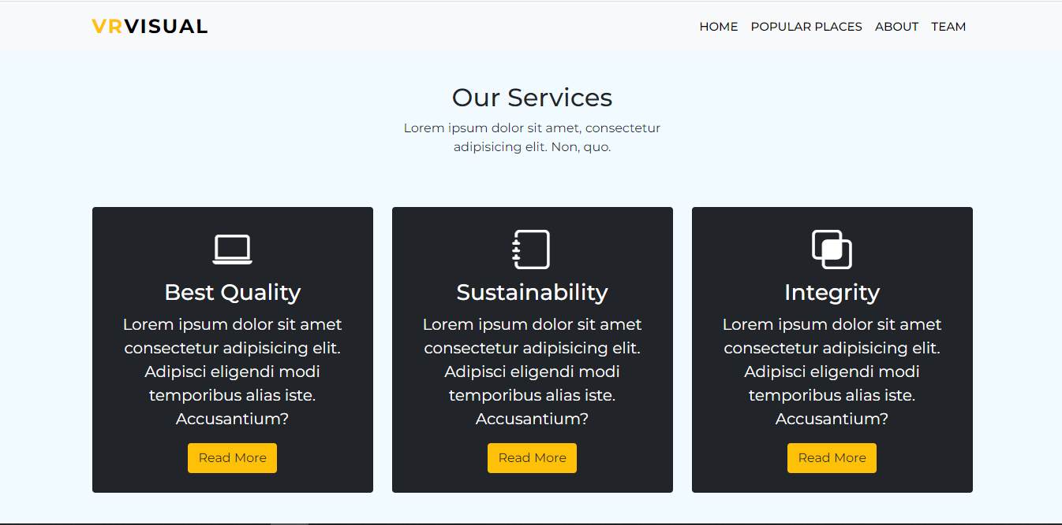
EXAMPLE :
dfdfdfdf
On Mobile Website View

Slide 10
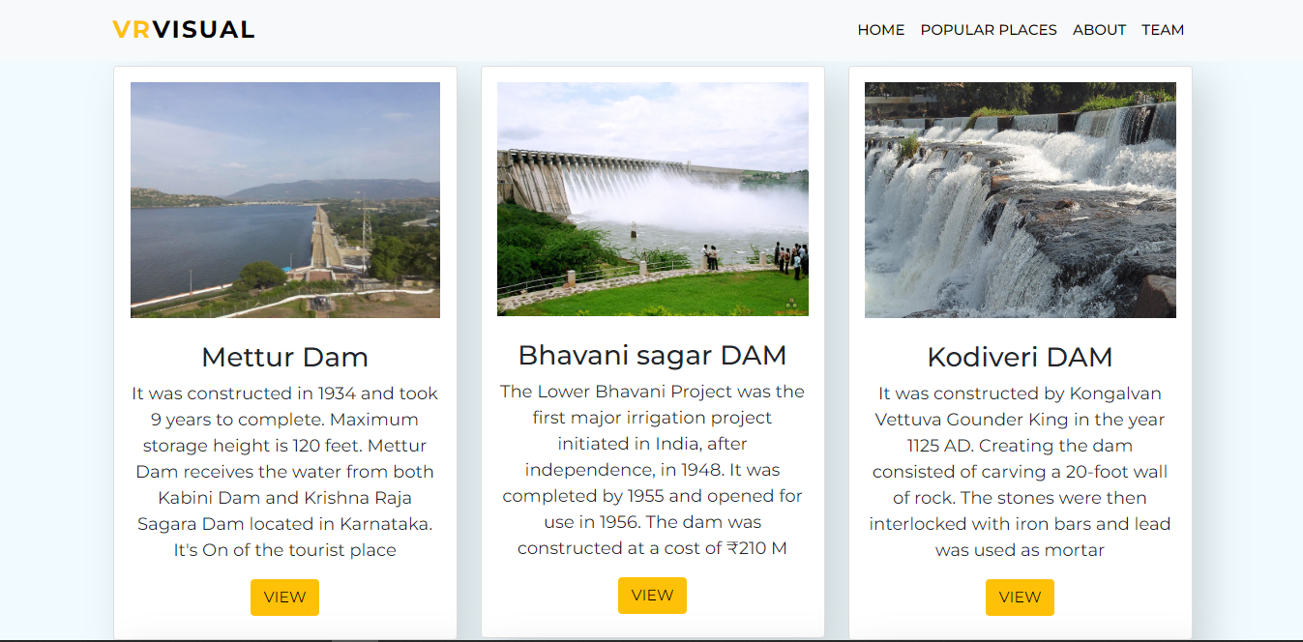
EXAMPLE :
dfdfdfdf
On Mobile Website View

Slide 11
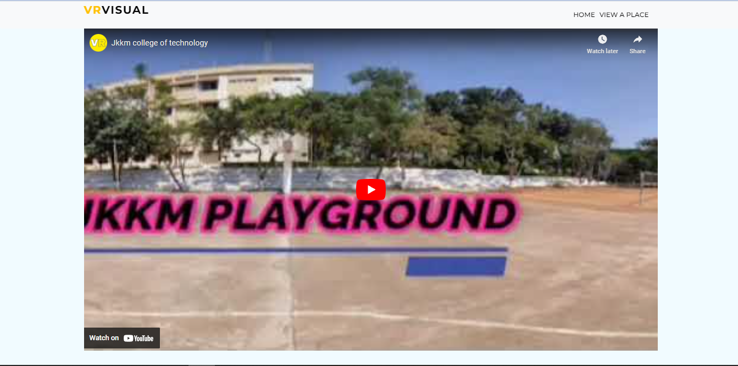
EXAMPLE :
dfdfdfdf
On Mobile Website View

Slide 12
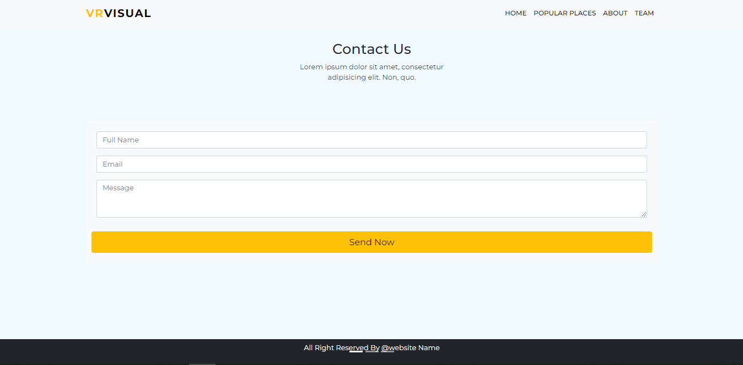
EXAMPLE :
dfdfdfdf
Suggestion Page

Slide 13
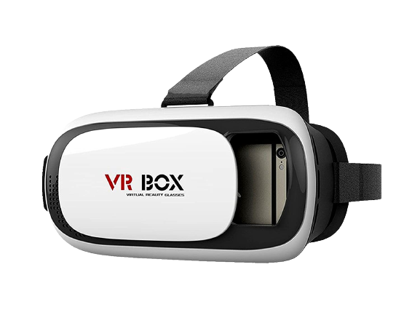
Virtual reality VR Box headset is a head-mounted device that you wear over your eyes like a pair of goggles. This VR device provides virtual reality for the wearer. The goal of the VR headset is too provide immersive virtual reality experience

Slide 14
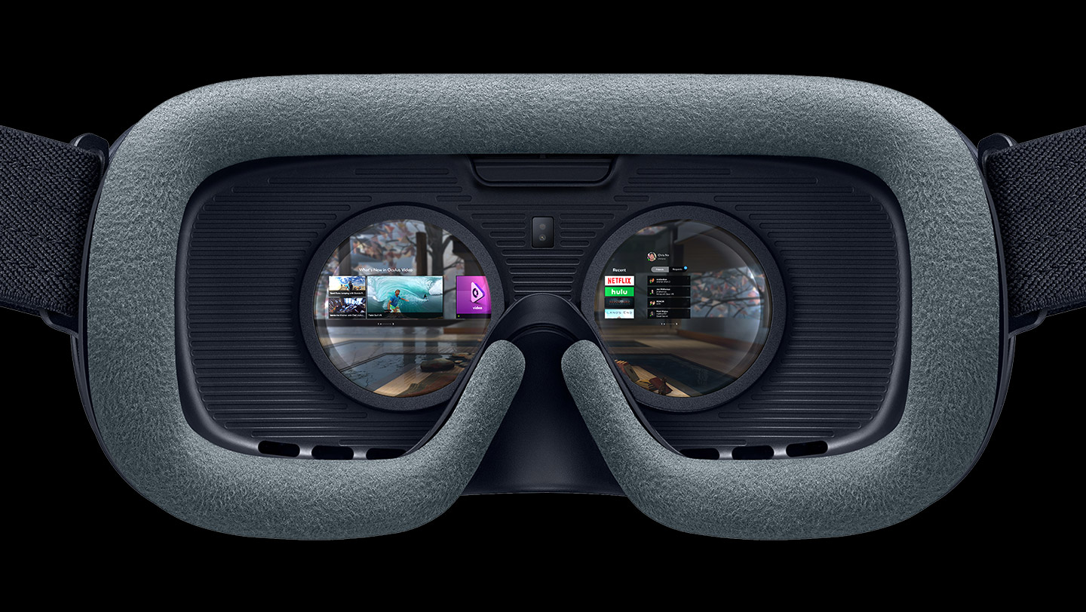
Inside View Of VR Box

Slide 15
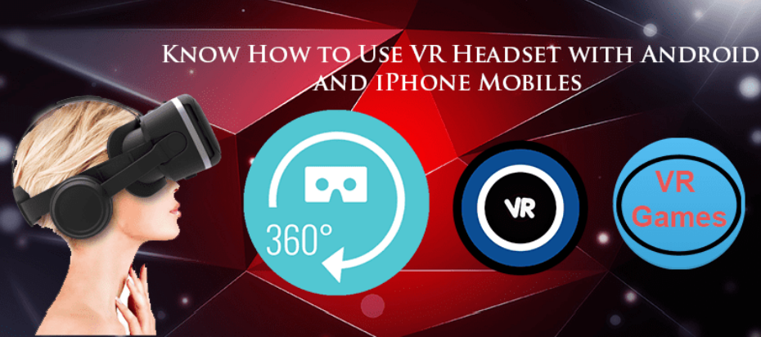
Visit a Places On 360 Degree Using VR Box

Slide 16
THANK YOU !!!

